Slide 1
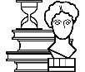
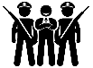
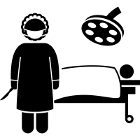
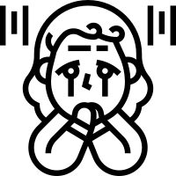
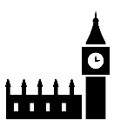
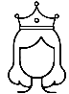
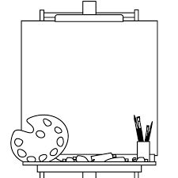
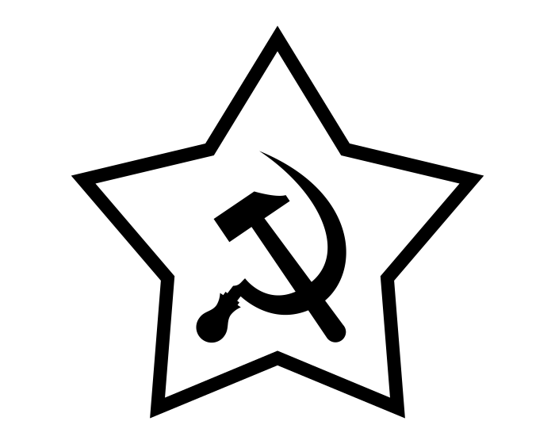
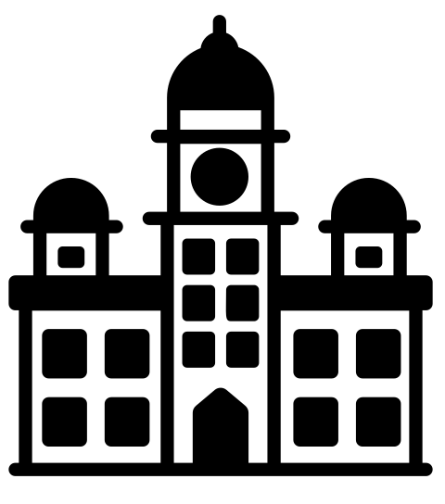
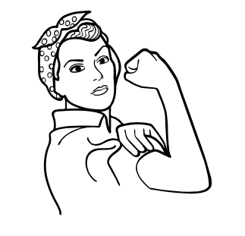
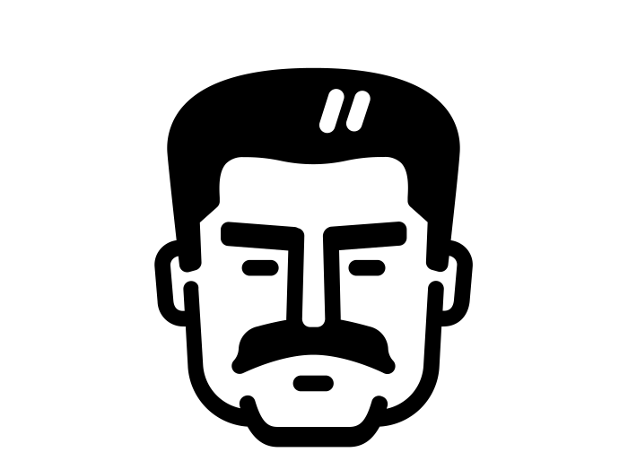
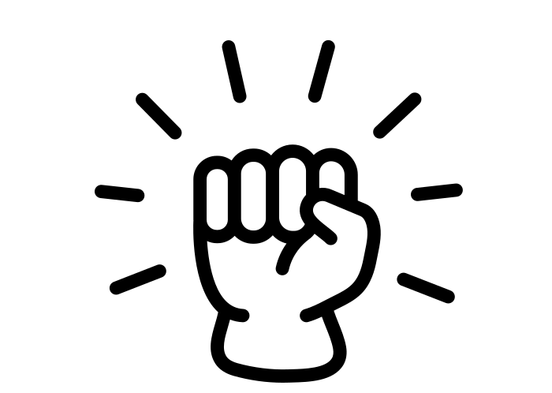
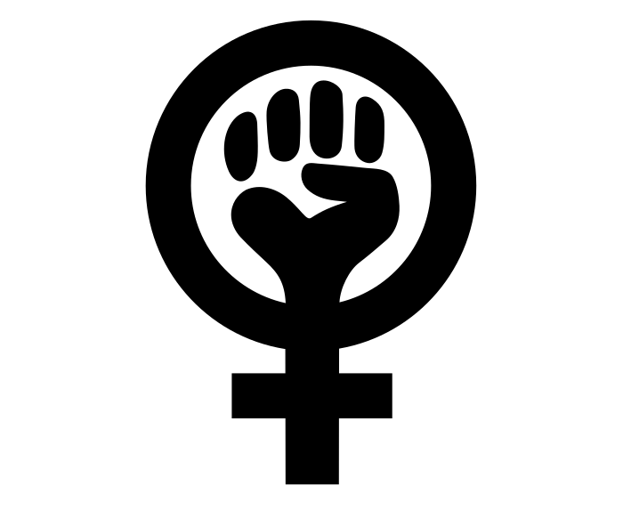
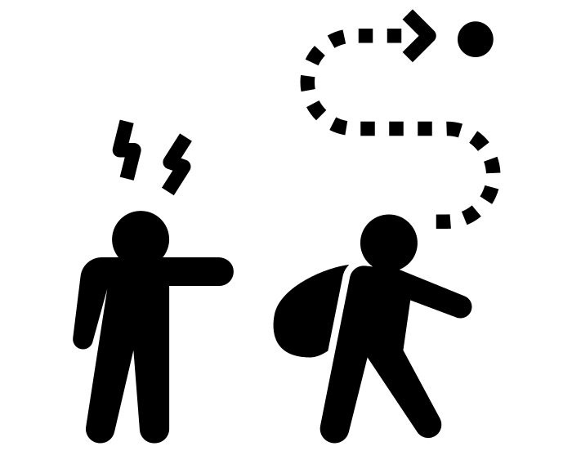
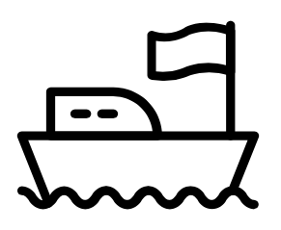
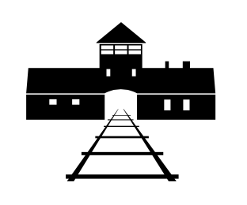
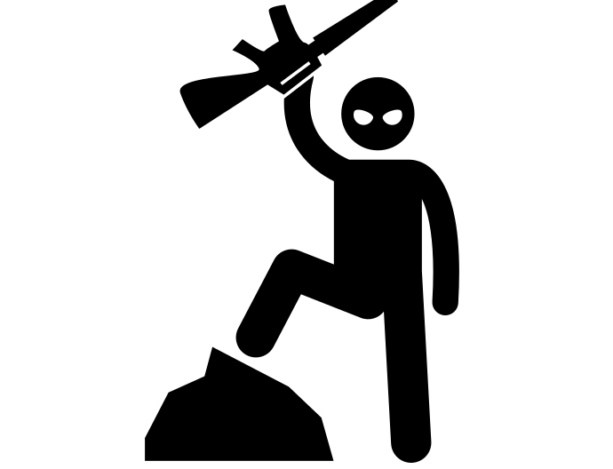
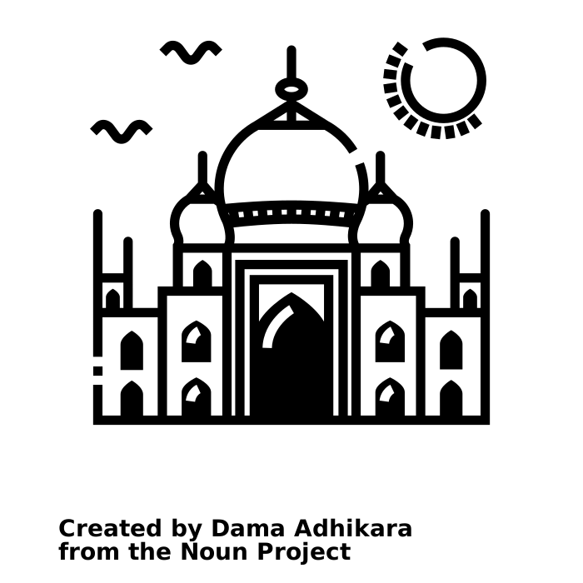
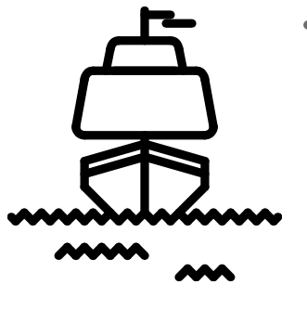
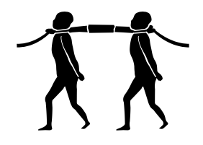
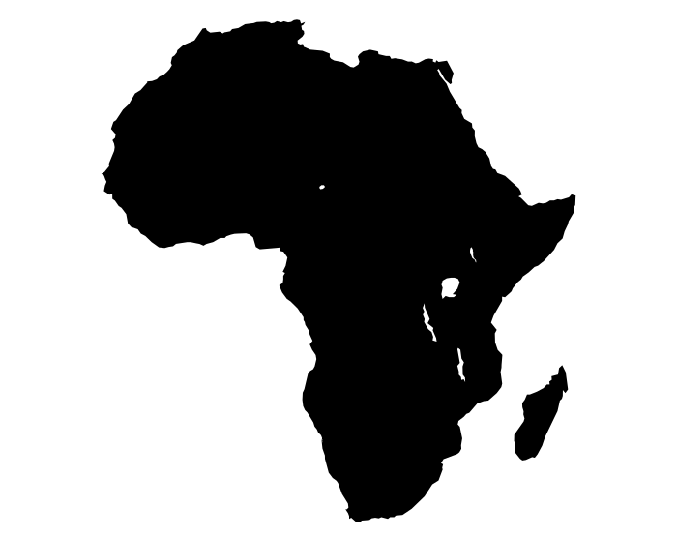
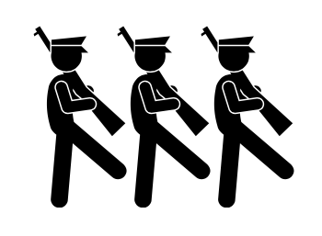
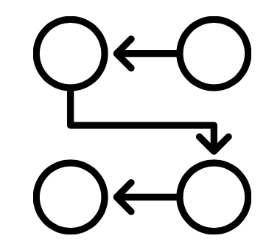
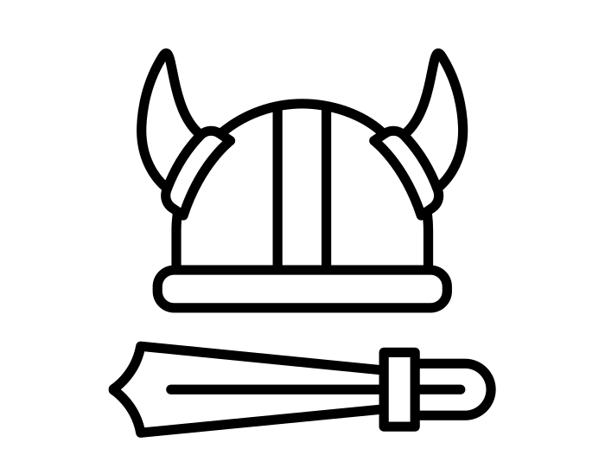
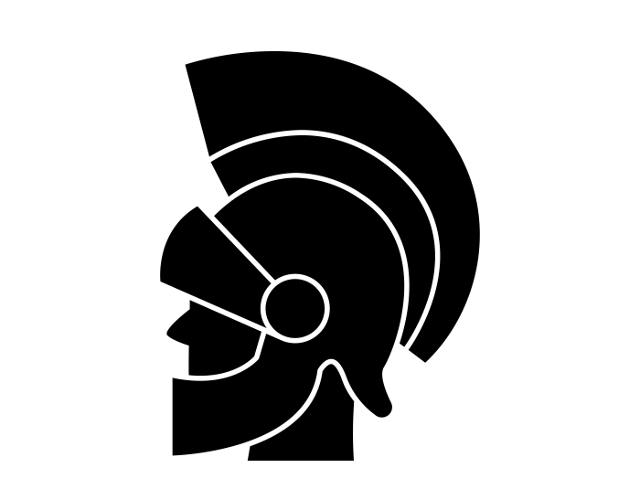
The Five-Year Curriculum: History
To Develop Independent Critical Thinkers
Recap topics
Practice exam questions
GCSE HISTORY
Exam preparation
The role of Edwin Chadwick and the significance of the Public Health Acts
Changes in Public Health & Case Study
Exam question focus based on previous mocks
Recall games
Liberal Reforms of the early 20th Century
Barber surgeons to
cancer therapies
The significance of John Snow
Unification of German speaking people
Reverse the Treaty of Versailles
Education under the Nazis
Patient care
Significance of Vesalius, Pare and Harvey
The significance of Edward Jenner
Persecution of the Jews
Hitler’s use of fear and propaganda
Treatment & medical knowledge
Medicine C500-present
Causes and prevention of illness
Hitler’s Foreign Policy
Life in Nazi Germany
Establishment and impact of the NHS
How did Hitler consolidate his power?
Role and significance of Florence Nightingale
Significance of Germ Theory
Warfare, poverty, industrial illness and viral illnesses
Increase living space
How did Hitler solve unemployment?
Rise of Hitler
How did Hitler become the Fuhrer?
Use of propaganda
Use of stormtroopers
The Religious Settlement
The Northern Rebellion
Catholic Plots
Causes, events and consequences of the Spanish Armada
Entertainment of the rich
The role and significance of theatre
Impact of the Treaty of Versailles through source analysis
Year
11
The Munich Putsch
The role of local government
The Catholic and Puritan threat
Elizabethan society and popular entertainment
Germany in Transition – Weimar Germany
The Royal Court, Privy Council and Parliament
Elizabethan England – Governance and religion
How significant a threat was Mary Queen of Scots?
Puritans challenges
Entertainment of the poor
Interpretation Question that life was all bad for the poor
Weaknesses of the Weimar Government
Early challenges of the Weimar Government
What was the causes and consequences of Hyperinflation
Capitalism Vs Communism
Protest
movements
Economic/social policies of Reagan, Bush Snr and Clinton
Civil Rights Legislation and the Black Power Movement
The effects of the Wall St Crash
Government reactions to terrorism
Women’s progress
The New Deal
USA
Cold War
Elizabeth’s popularity
USA – Main Political Changes
USA – Civil Rights
USA – Economic Change
Year
10
Leaders of terrorist groups
The end of the USSR and the Cold War
USA – Social
Change
Role of religion, ideology and nationalism
Early flashpoints of the Cold War
How has terrorism
affected the world?
The Cuban
Missile Crisis
Teenagers behaviour
Rock and Roll
The Watergate Scandal
Domestic policies of JFK/LBJ
The role of Martin Luther King
Early success though peaceful protest
Terrorist Group aims, motives and methods
Causes of Terrorism
Contribution of soldiers from around the world
How did Stalin control Russia
How should we remember Churchill
Changes in technology
The 1905 Revolution
The 1917 Revolution
The D-Day
Invasion
What are the origins of the Holocaust?
Local History – Liverpool during the Blitz
How has British Society
changed after
World War II?
The suffragettes and contribution of women
The Treaty of Versailles
Concentration Camps
Teen rebellion
Trench Warfare
The Collapse of Tsarist Russia
and rise of Communism
World War II
The Holocaust
Changes in the role and attitudes towards women post WW2
World War I
Dunkirk
The Nuremburg
Laws
The Final Solution
Immigration to Britain, experiences and contributions
The assassination of Franz Ferdinand
Long term causes of WW1
Stalin’s purges
The Battle of Britain
Dropping the Atomic Bomb
Life in the Ghettos
Year
9
Interpretations of General Haig
Legacy of the British Empire
Local History – Liverpool’s role in the slave trade
Punishments through the ages
The Bloody Code
Empire Strikes Back
The jewel in the Crown
Factory conditions
Life in England 1750-1900
The abolition of the slave trade
The Middle Passage
Who was Jack the Ripper?
Crime and Punishment
Through Time
The Impact of the British Empire
How did the Industrial Revolution change Britain?
The International
Slave Trade
Why did the slave trade happen?
Local History – The Up Holland Highway Robber
Crime through the Ages
Scramble for Africa
The growth of the British Empire
The growth of factories
Local History Study - Wigan Pier
Interpretations of Oliver Cromwell
When did Parliament become more powerful than the monarchy?
Gandhi and Independence
The trial of King Charles
The English
Civil War
Which event had the most significant impact on improving the life of peasants?
Why did Charles lose?
Was King John a cruel and weak King?
The birth of Parliament
What was Henry VIII like?
The English Reformation
Causes of
the Civil war
Chaos and Upheaval in Medieval England
Women that shaped the world
Year
8
Exploring different
interpretations of
King John.
Turmoil under the Tudors
The Spanish Armada
The significance of the Magna Carta
The Black Death
The causes, events and consequences of the Peasants
Revolt
Did Bloody Mary deserve her nickname?
Elizabeth’s Religious Settlement
How should we remember King John’s reign?
How did the Saxons defeat the Vikings at Stamford Bridge?
Medicine, and crime
In Medieval
times
Motte and Bailey and Square Keep Castles
Why did William win the Battle of Hastings extended writing
Who should be king in 1066?
Were Vikings just warriors?
Black Romans in Britain
A JOURNEY
King John’s problems
Year
7
How important was religion in the Middle Ages?
Life in Medieval England
The Norman Conquest
of England
Introduction to
Historical Skills
How has football changed since the Middle Ages?
What was life like in Medieval villages and towns?
How did William use the Domesday Book and Feudal System to increase his control over England?
Why did William Duke of Normandy win the Battle of Hastings?
Women in the Dark Ages?
What happened at Pompeii?
THROUGH TIME

