Slide 1
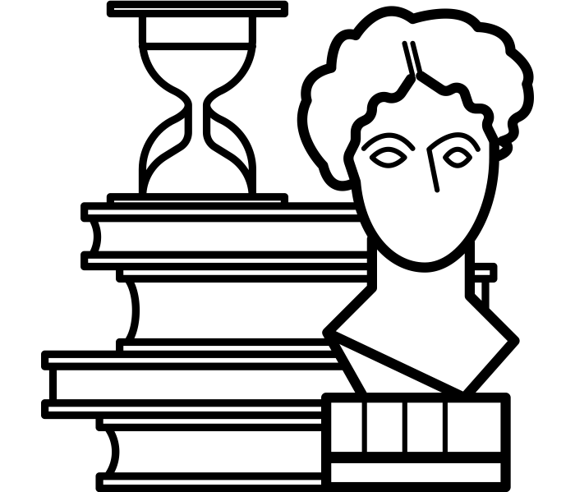
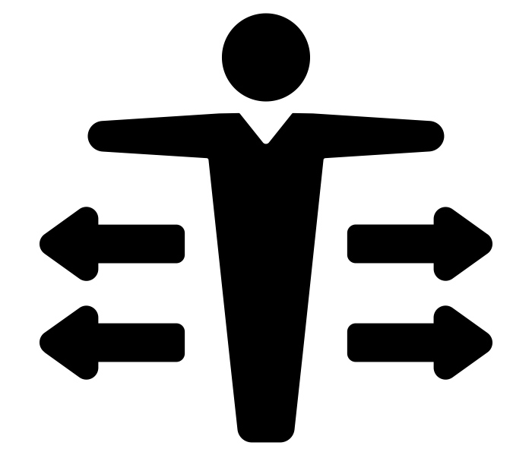
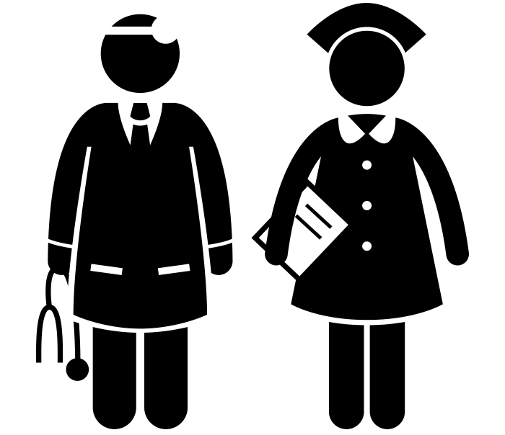
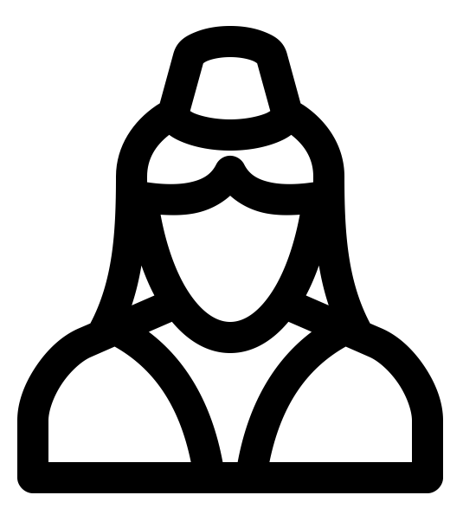
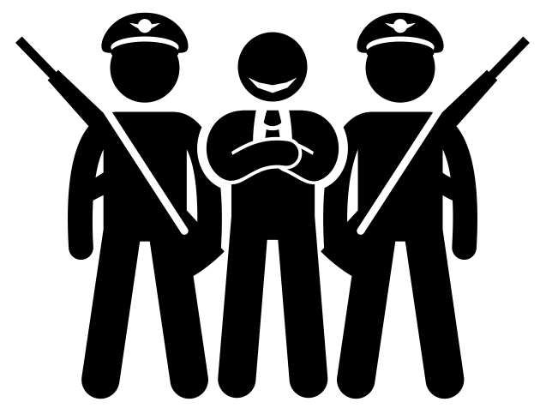
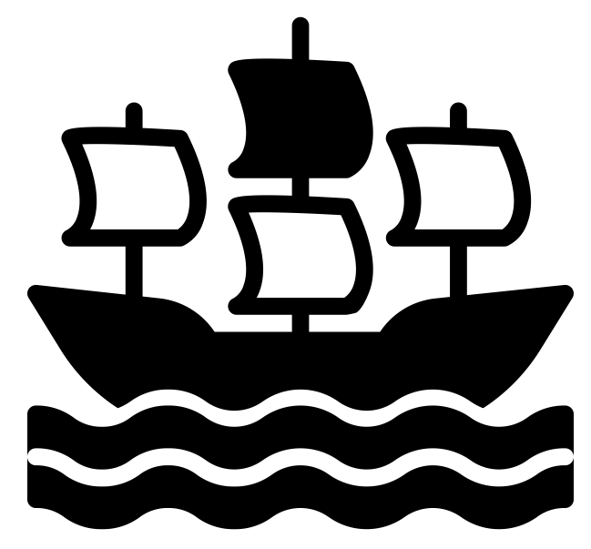
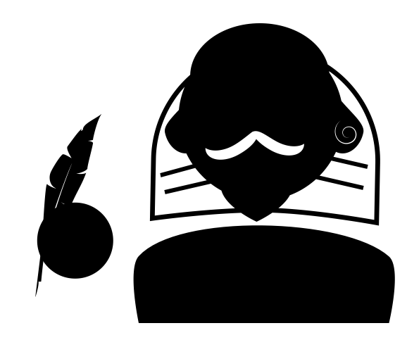
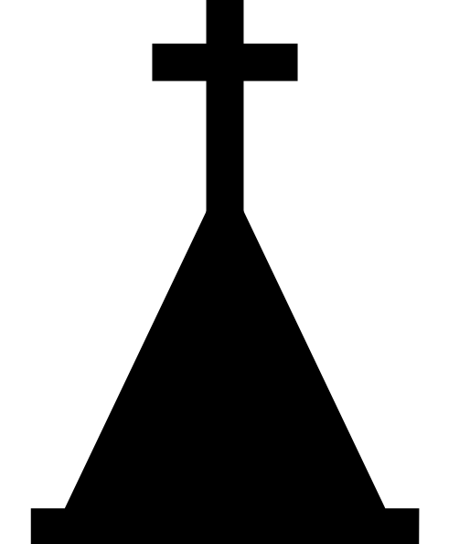
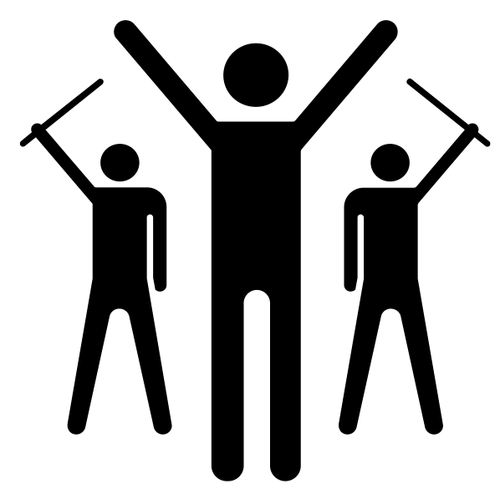
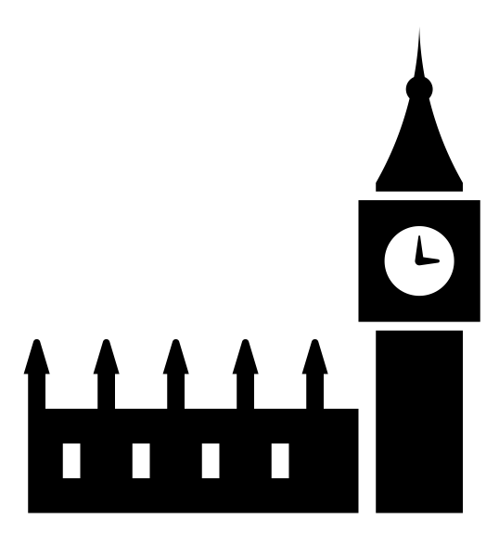
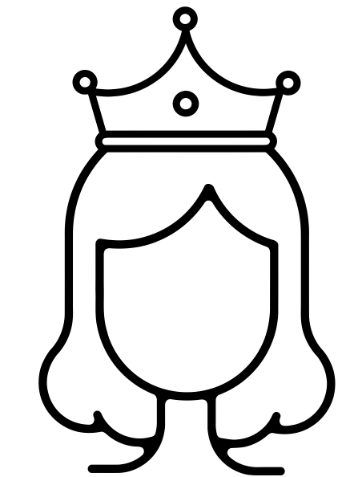
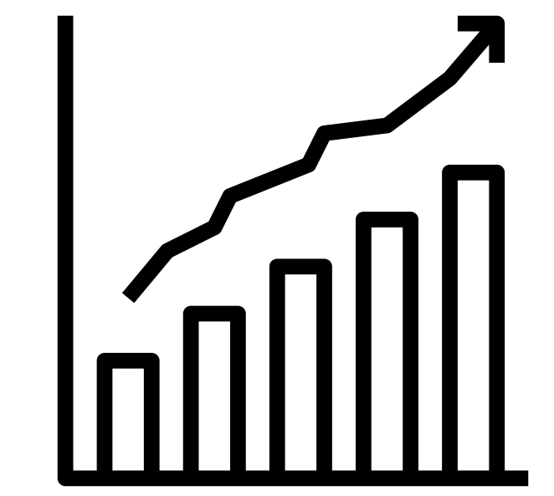
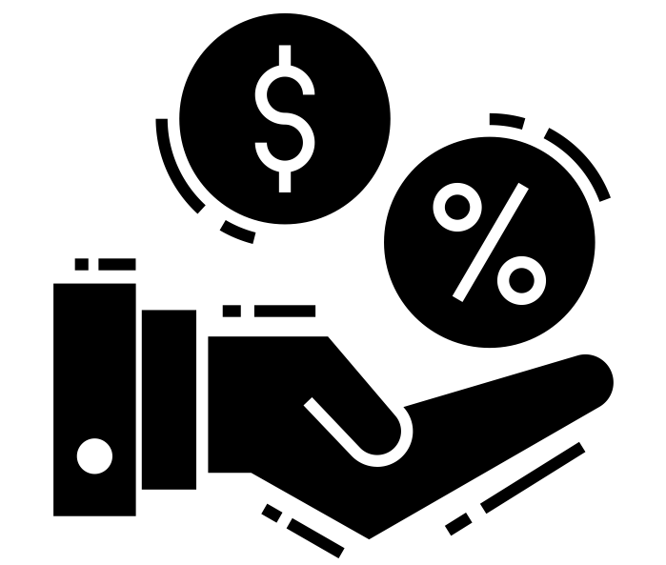
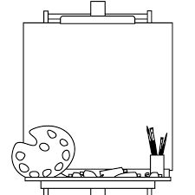
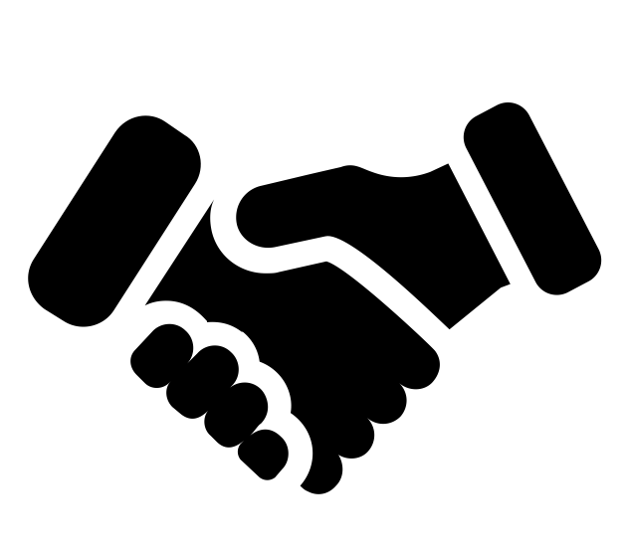
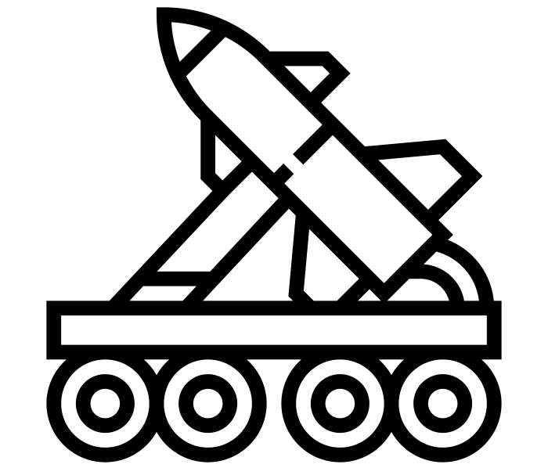
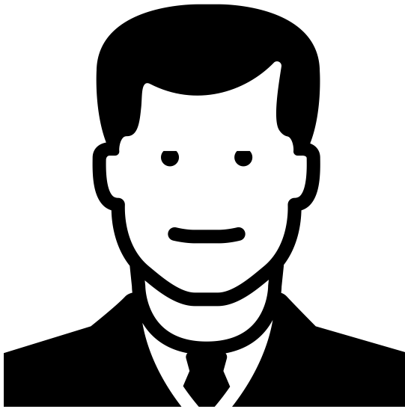
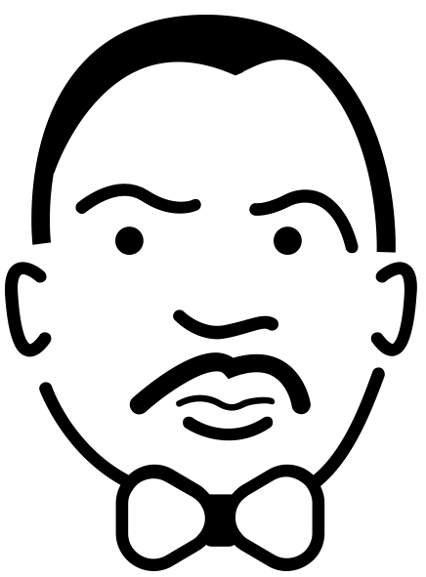
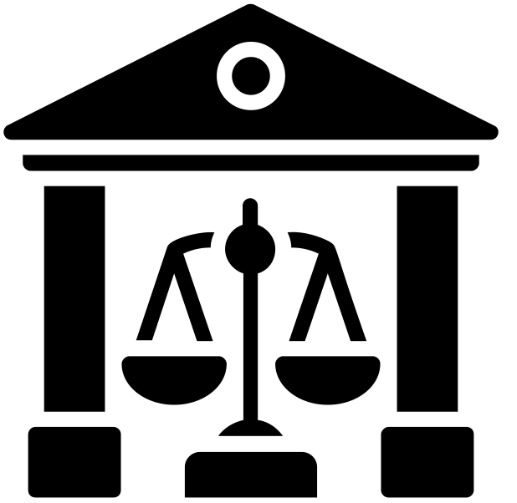
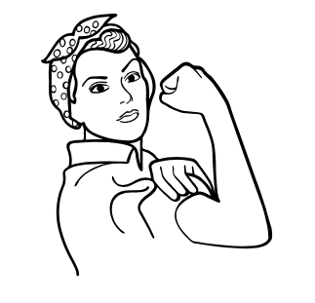
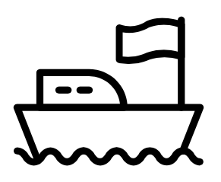
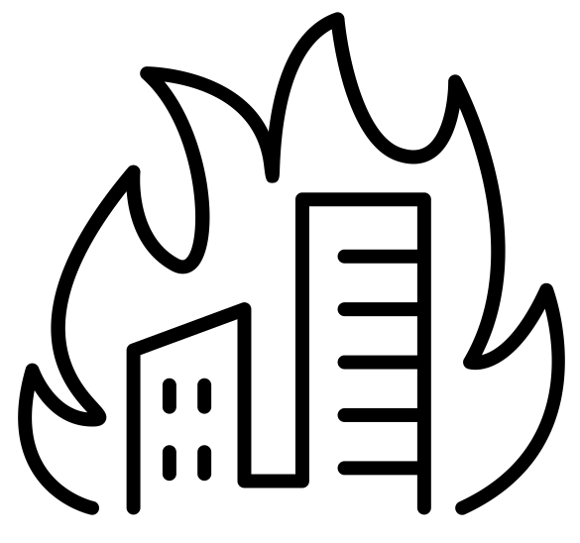
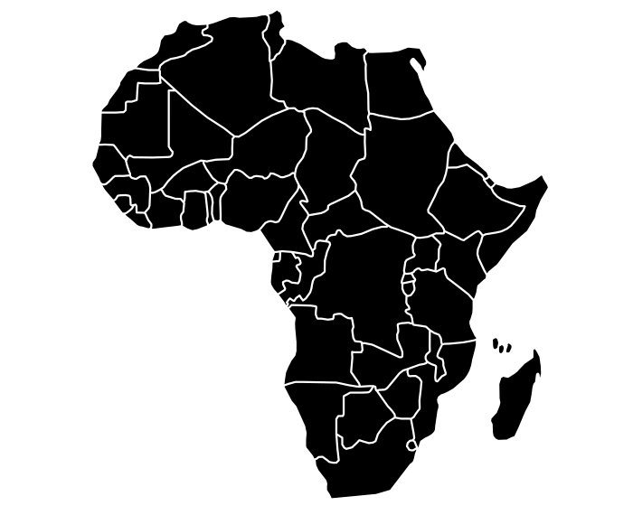
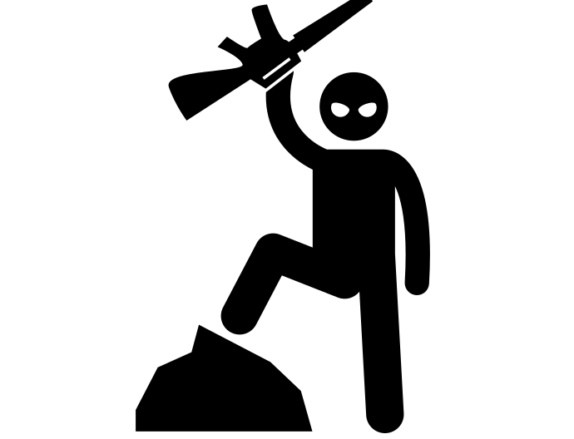
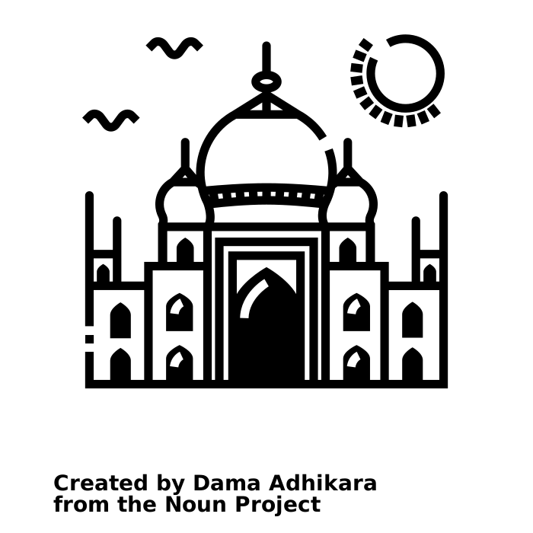
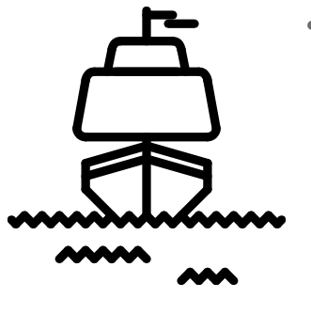
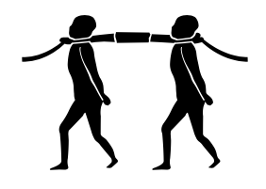
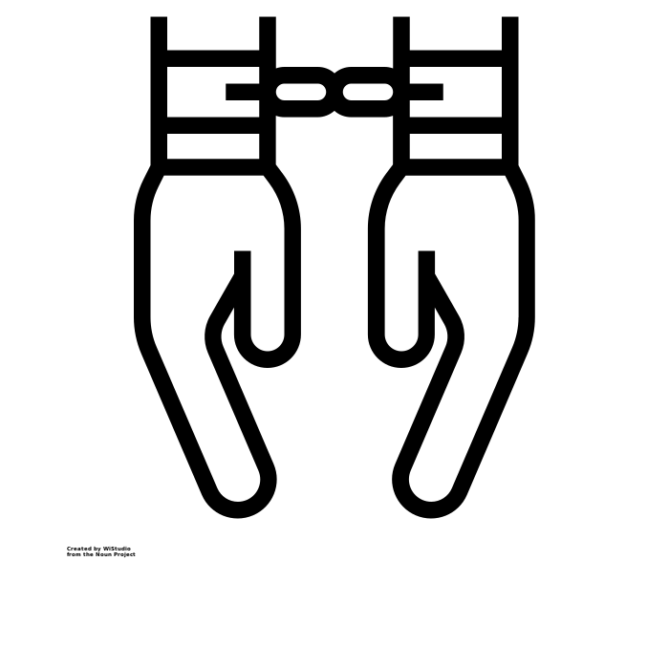
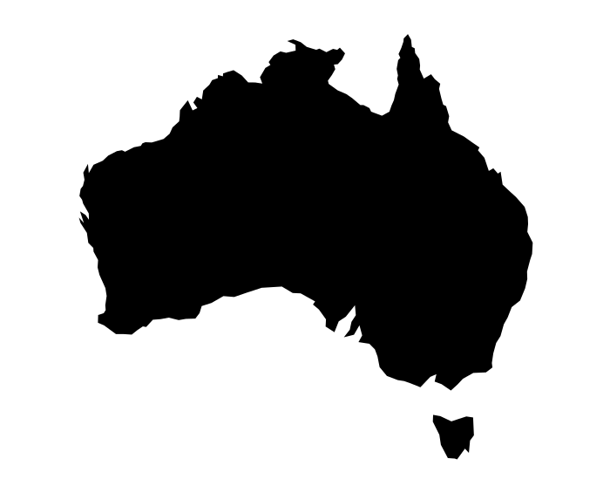
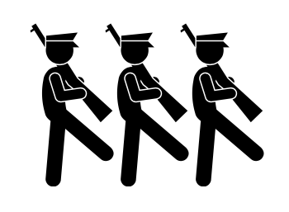
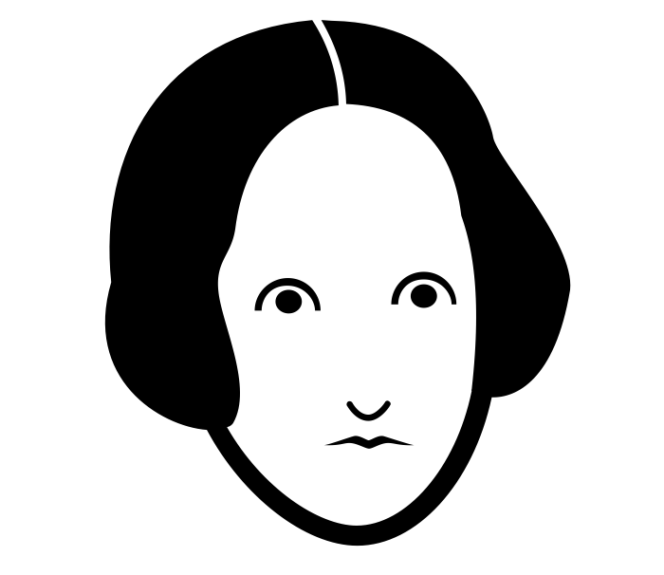
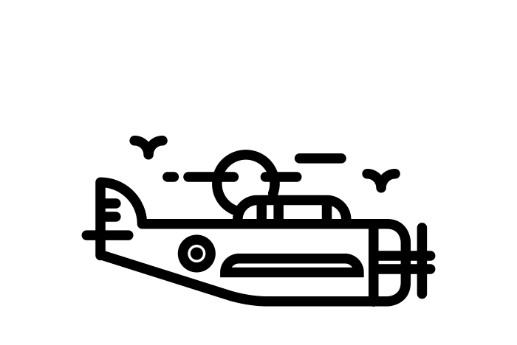
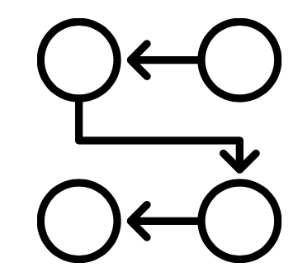
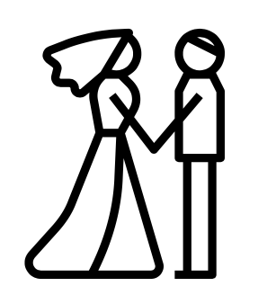
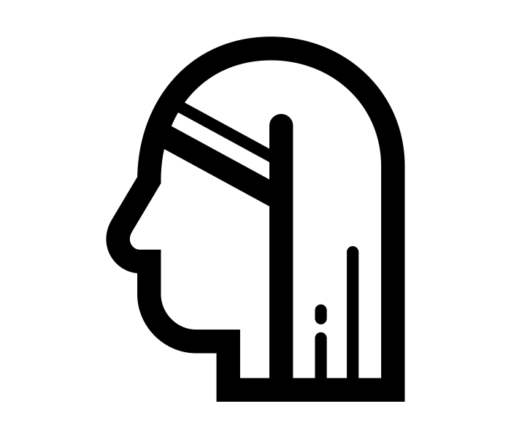
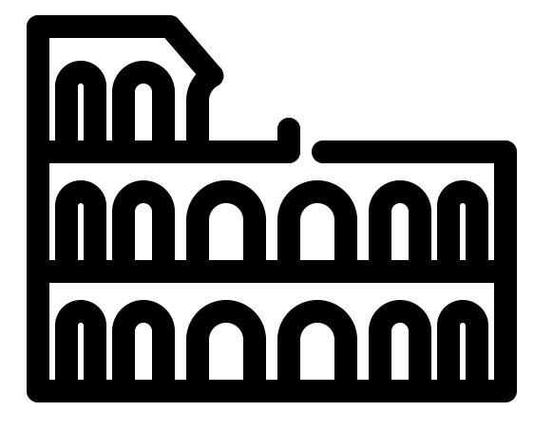
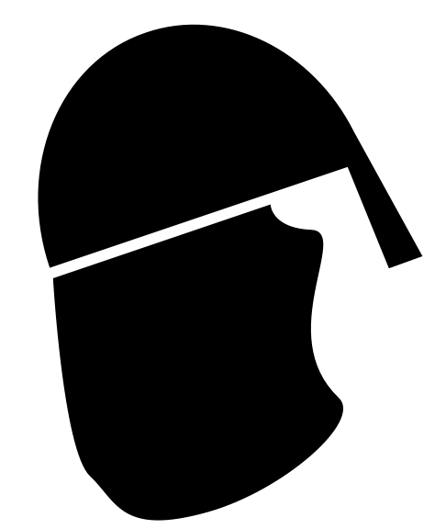
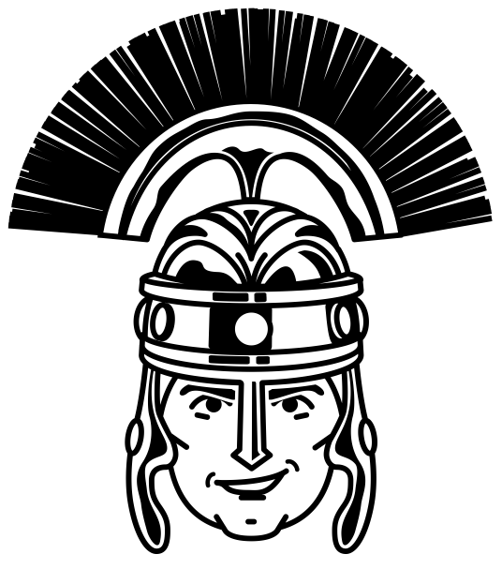
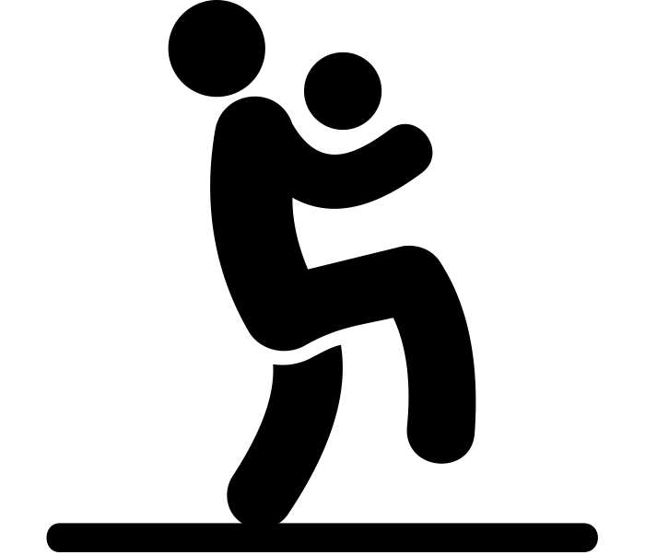
The Five-Year Curriculum: History
To Develop Independent Critical Thinkers
Events/factors associated with the case study
Recap topics
Practice exam questions
GCSE HISTORY
Causes and background of the case study
Case Study – Differs every two years
Exam preparation
The role of Edwin Chadwick and the significance of the Public Health Acts
Changes in Public Health
Evaluation of the overall significance of the case study
Exam question focus based on previous mocks
Recall games
Liberal Reforms of the early 20th Century
Warfare, poverty, industrial illness and viral illnesses
Hitler’s use of fear and propaganda
Significance of Germ Theory
Significance of Vesalius, Pare and Harvey
Reverse the Treaty of Versailles
Increase living space
Persecution of the Jews
How did Hitler solve unemployment?
Establishment and impact of the NHS
Patient care
Treatment and medical knowledge
Medicine C500-present
Causes and prevention of illness
Hitler’s Foreign Policy
Life in Nazi Germany
Role and significance of Florence Nightingale
Education under the Nazis
How did Hitler consolidate his power?
Barber surgeons to cancer therapies
The significance of Snow and Jenner
Unification of German speaking people
Impact of the Treaty of Versailles through source analysis
How did Hitler become the Fuhrer?
Rise of Hitler
The Religious Settlement
The Northern Rebellion
Catholic Plots
Causes, events and consequences of the Spanish Armada
Entertainment of the rich
The role and significance of theatre
Early challenges of the Weimar Government
Year
11
The Munich Putsch
The role of local government
The Catholic and Puritan threat
Elizabethan society and popular entertainment
Nazi Germany – Weimar Germany
The Royal Court, Privy Council and Parliament
Elizabethan England – Governance and religion
How significant a threat was Mary Queen of Scots?
Puritans challenges
Entertainment of the poor
Interpretation Question that life was all bad for the poor
Weaknesses of the Weimar Government
What was the causes and consequences of Hyperinflation
Detente
Early flashpoints
Economic/social policies of Reagan, Bush Snr and Clinton
Civil Rights Legislation and the Black Power Movement
Protest
movements
Elizabeth’s popularity
USA – The Cold War
USA – Main political changes
USA – Civil Rights
Year
10
Women’s progress
The end of the USSR and the Cold War
USA – Social Change
Life in suburbia
The Cuban
Missile Crisis
The Watergate Scandal
Domestic policies of JFK/LBJ
The role of Martin Luther King
Early success though peaceful protest
Rock and Roll
Teenagers behaviour
USA – The Great Depression Depth Study
The New Deal
The case of Harry Farr
The Treaty of Versailles
The D-Day
Invasion
Terrorist Group aims, motives and methods
The effects of the Wall St Crash
Dunkirk
Pearl Harbour
How should we remember Churchill
1960s Britain and equal rights
What are the origins of the Holocaust?
Concentration Camps
Government reactions to terrorism
Propaganda posters
WW2 and how
Britain changed afterwards
The Holocaust
How effective has terrorism been in the Modern Age?
Leaders of terrorist groups
Trench Warfare
The World at War
WW1 weapons
The Battle of Britain
Creation NHS
Role of religion, ideology and nationalism
Dropping the Atomic Bomb
The Nuremburg
Laws
The Final Solution
The assassination of Franz Ferdinand
Life in the Ghettos
Causes of Terrorism
Long term causes of WW1
Year
9
Interpretations of General Haig
Scramble for Africa
Punishments through the ages
The Bloody Code
Empire Strikes Back
The jewel in the Crown
Factory conditions
Life in England 1750-1900
The abolition of the slave trade
The Middle Passage
Crime and Punishment
Through Time
The Impact of the British Empire
How did the Industrial Revolution change Britain?
Slave
punishments
Why did the slave trade happen?
Peterloo and the Suffragettes protest
The impact of Empire in shaping modern Britain
The growth of factories
The International
Slave Trade
Explore African culture in the 17th century?
Who was Jack the Ripper?
Crime through the Ages
Finding Australia
The growth of the British Empire
Interpretations of Oliver Cromwell
The trial of King Charles
Roundheads and Cavaliers
Monarchy
Vs
Parliament
Which event had the most significant impact on improving the life of peasants?
Why did Elizabeth not marry?
Why did Charles lose?
Was King John was a cruel and weak King?
The birth of Parliament
The problems Henry Vii faced
The English Reformation
Causes of
the Civil war
Chaos and Upheaval in Medieval England
Women that shaped the world
Year
8
The Spanish Armada
Exploring different
interpretations of
King John.
Turmoil under the Tudors
Elizabeth’s Religious Settlement
The significance of the Magna Carta
The Black Death
The causes, events and consequences of the Peasants
Revolt
What was Henry VIII like?
Henry VIII and his many wives
Did Bloody Mary deserve her nickname?
Power and Conflict in the Medieval Period
Life in Tudor England
Rich and poor
comparison
Medicine, religion and crime
Explain how William won the throne
The Dark Ages source analysis
What was life like as a Roman?
Who were the Romans?
A JOURNEY
King John’s problems
Year
7
Life in Medieval England
How was England lost?
How did the Romans change Britain?
Was it all bad in Medieval England?
How has football changed since the Middle Ages?
Compare life in Medieval villages and towns
Local study: Clitheroe Castle
How did William control the English?
Who should be king in 1066?
What have the Romans done for us?
THROUGH TIME
Why was the Roman army so successful?

